Slide 1
CS 316: Introduction to Deep Learning
Logistics and Introduction
Week 1
Dr Abdul Samad

Slide 2
Lecture Outline
Idea of Machine Learning Software
Key Components of Machine Learning
Kinds of Machine Learning Problems
Road to Deep Learning
Examples of Deep Learning Problems

Slide 3
How to Design Software Solutions.
Can we write programs for the following:
To predicts weather given geographic information,
satellite images, and a trailing window of past weather.
That takes in a question, expressed in free-form text, and answers it correctly.
Given an image can identify all the people it contains,
drawing outlines around each.
Presents users with products that they are likely to enjoy but unlikely, to encounter.

Slide 4
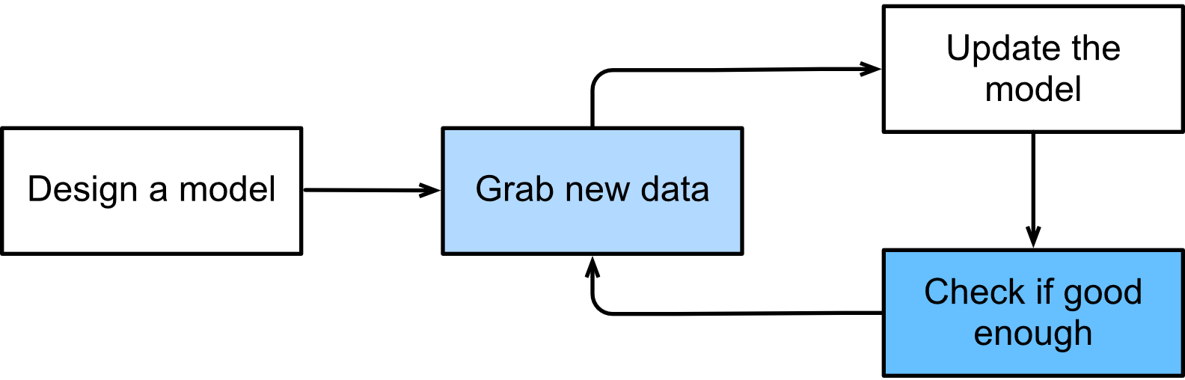
Training Process in Machine Learning
Figure taken from d2l.ai

Slide 5
Key Components of Machine Learning
Data
Model
Objective Function
Optimization Algorithm

Slide 6
Data
A collection of examples consists of sets of attributes called features.
In each example, there is a designated label attribute to predict.
Features can have a fixed or variable length.
The quantity of data available determines the effectiveness of deep learning models.
It is important to ensure high-quality data because the output depends on the input.
The data can be biased, such as through CV filtering.

Slide 7
Model
The computational machinery for ingesting data of one type and spitting out predictions of a possibly different type.
Can be estimated from the data.
Deep learning models are much more complicated than traditional models.

Slide 8
Objective Function
To improve our ability to perform a task over time, we need to learn from our experiences.
Objective function evaluates the quality of our models.
The lower the objective function value, the better the model is considered to be.
It is also known as the loss function.
Mean Squared Error is used for numerical data whereas accuracy is used for categorical data.
To avoid overfitting, we keep track of both the training and test losses.

Slide 9
Optimization Algorithm
Given a data source, a model, and a well-defined objective function, we need an algorithm capable of searching for the best possible parameters that minimize the loss function.
Gradient Descent
Stochastic Gradient Descent
Mini Batch Gradient Descent
Adam

Slide 10
Types of Machine Learning Problems
Supervised Learning
Regression
Classification
Unsupervised Learning

Slide 11
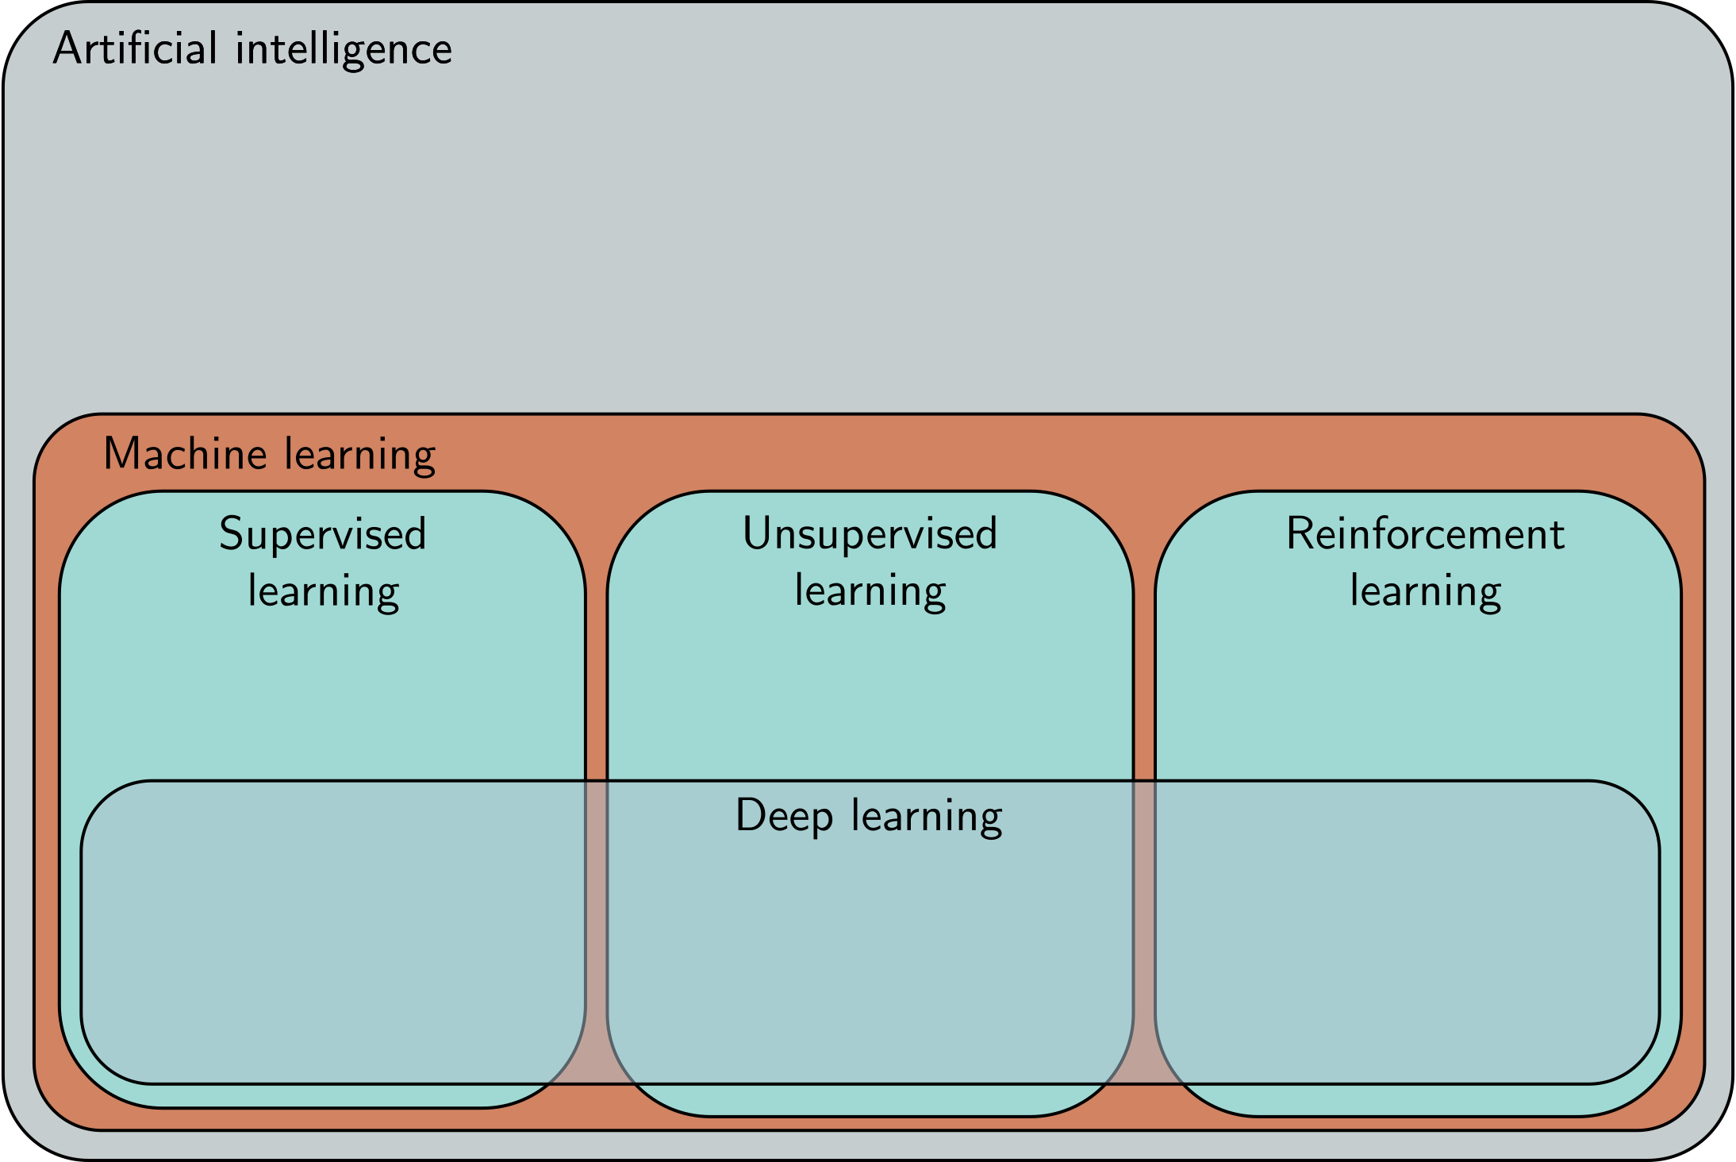

Slide 12
Supervised Learning
We aim to develop a model that maps input features to labels.
An example consists of a pair of features and a corresponding label.
For instance, "heart attack" or "no heart attack" is a label, while vital signs are input features.
In probabilistic terms, we're interested in estimating the conditional probability of a label based on input features.

Slide 13
Examples of Supervised Learning
Predict cancer vs. not cancer, given a computer tomography image.
Predict the correct translation in French, given a sentence in English.
Predict the price of a stock next month based on this month’s financial reporting data.

Slide 14
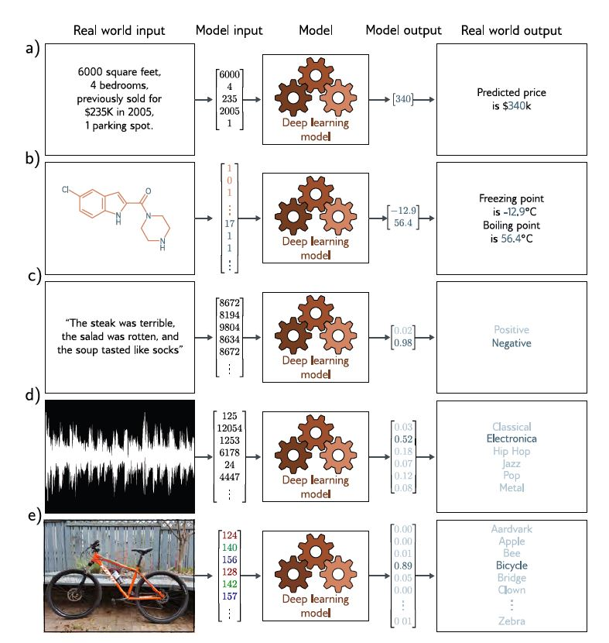

Slide 15
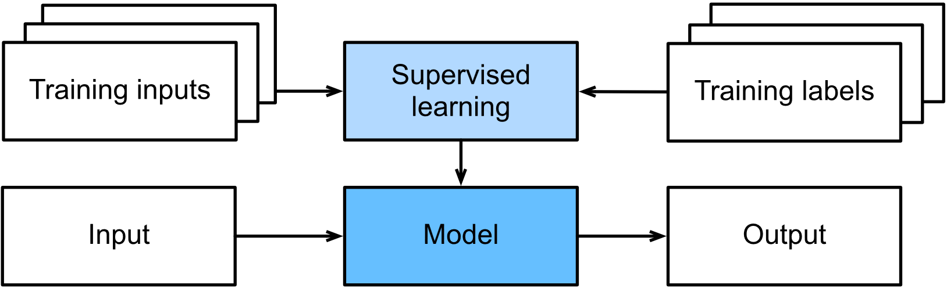
Supervised Learning System Diagram
Figure taken from d2l.ai

Slide 16
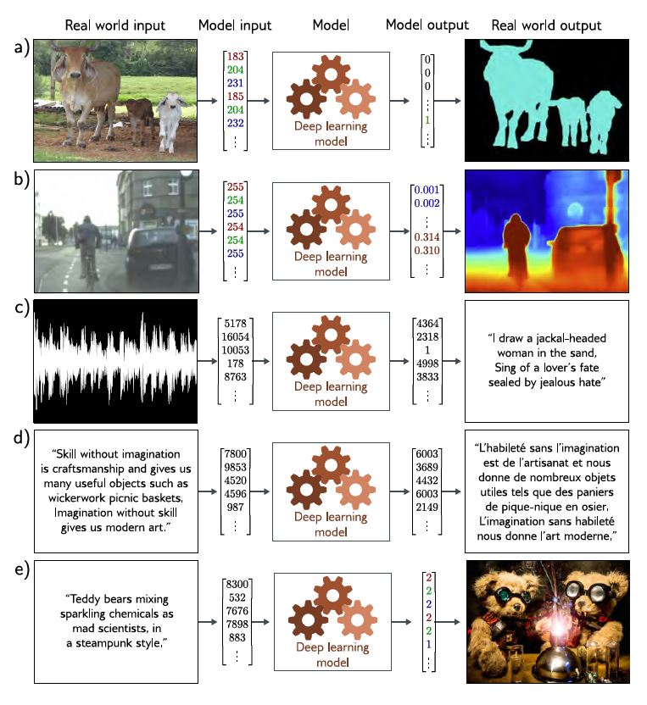

Slide 17
Supervised Learning - Regression
Label to predict is a numerical value.
House Price prediction
Predict the price of stock next month based on this month’s financial reporting data
How many hours will this surgery take?
How much rainfall will this town have in the next six hours?

Slide 18
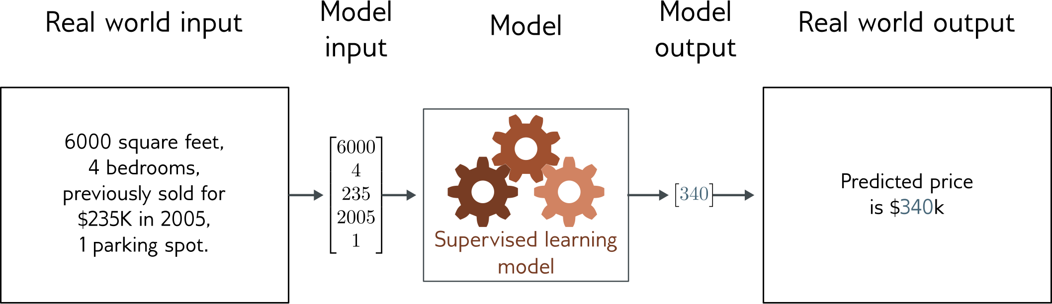
Regression
Univariate regression problem (one output, real value)
Fully connected network

Slide 19
Supervised Learning - Classification
Label to predict is a category or class.
Predict whether the image is of a cat or dog.
Predict whether the email is a spam or not.
Predict the author of a particular poem.

Slide 20
Unsupervised Learning
No specific labels have been assigned.
Can we group a given set of photos into categories such as landscape, dogs, babies, cats, and mountain peaks ?
Can we group a collection of users' browsing activities based on their similar behavior ?
Subspace estimation
Principal Component Analysis
Generative Adversarial Networks (GANs)

Slide 21
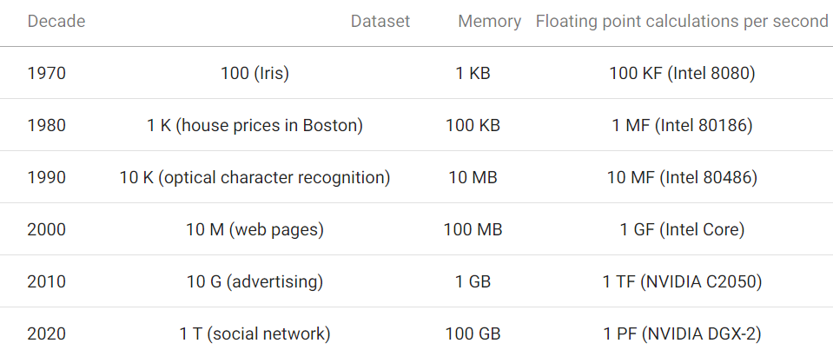
Road to Deep Learning
Figure taken from d2l.ai

Slide 22
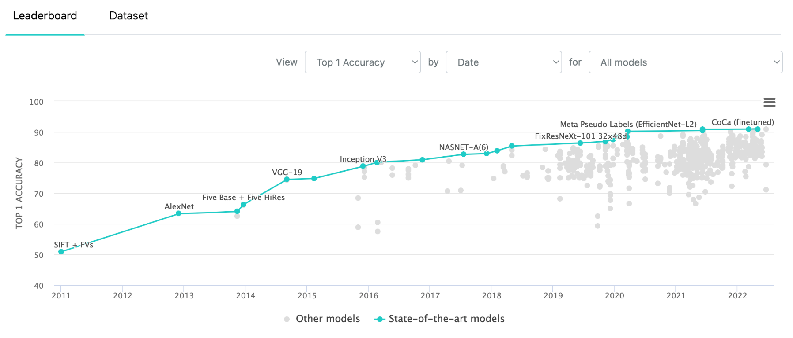
Classifying Images
Figure taken from thematic

Slide 23
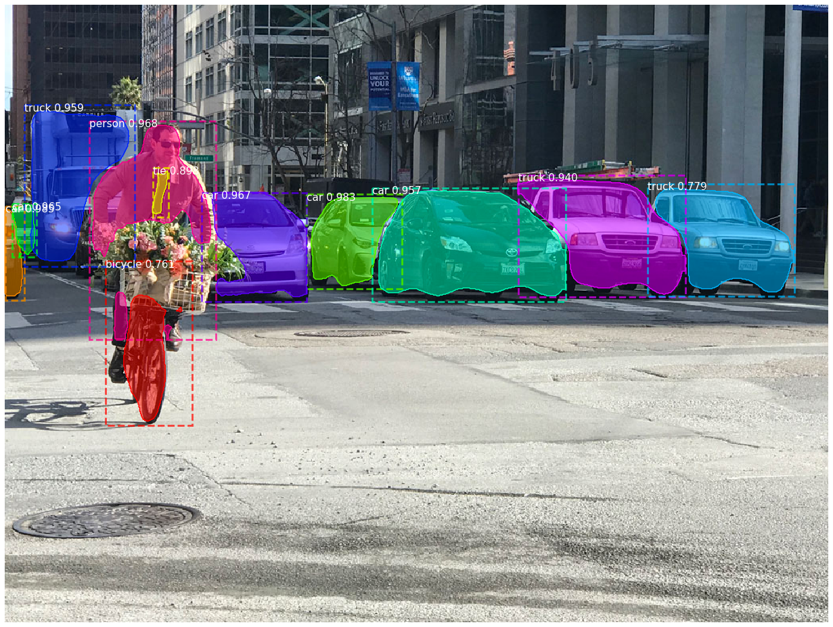
Object Detection and Segmentation
Figure taken from medium

Slide 24
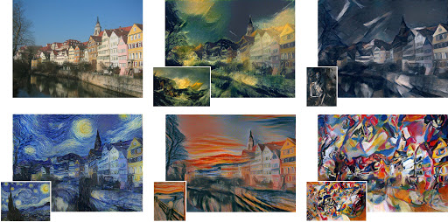
Image Style transfer
Figure taken from Analytics Vidhya

Slide 25
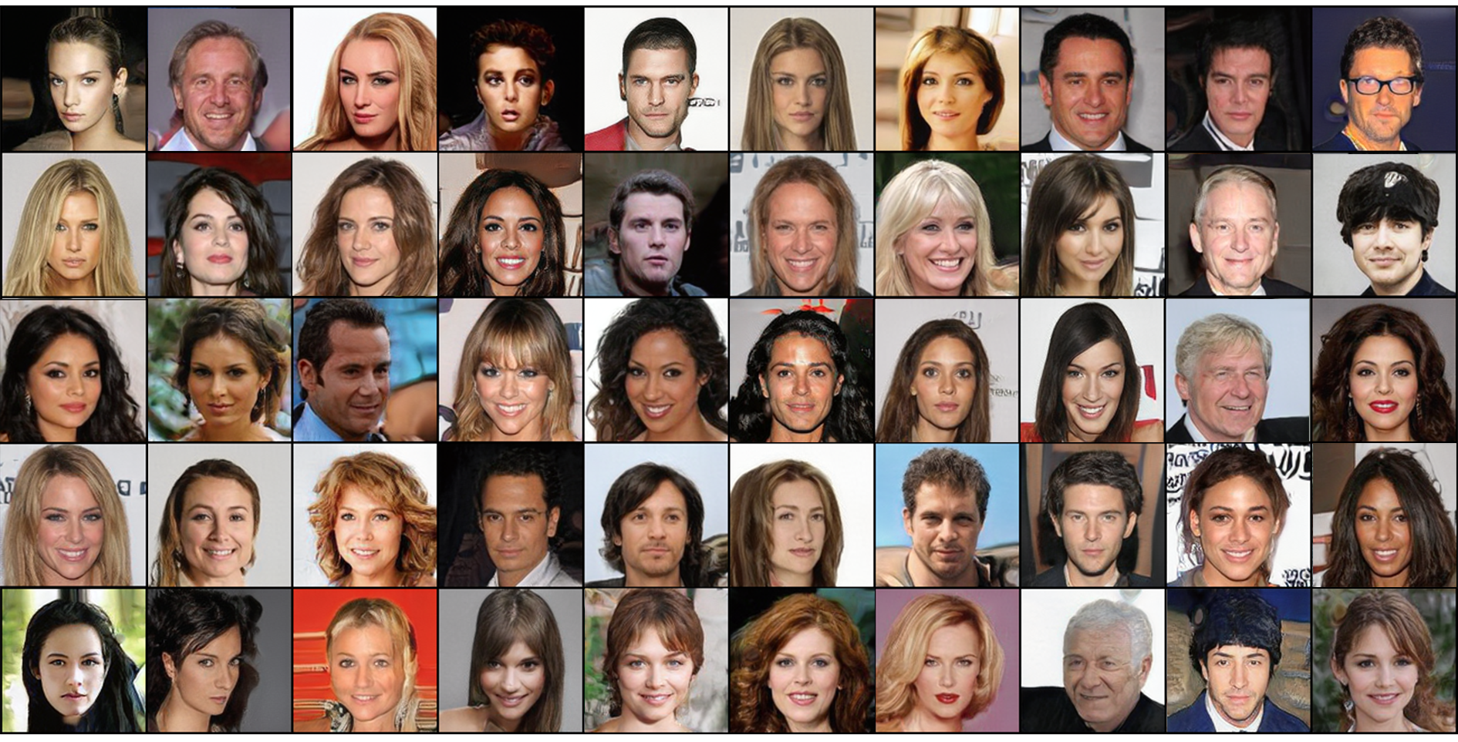
Synthesize Faces
Figure taken from medium

Slide 26

Analogies
Figure taken from medium

Slide 27

Machine Translation
Figure taken from pcmag

Slide 28
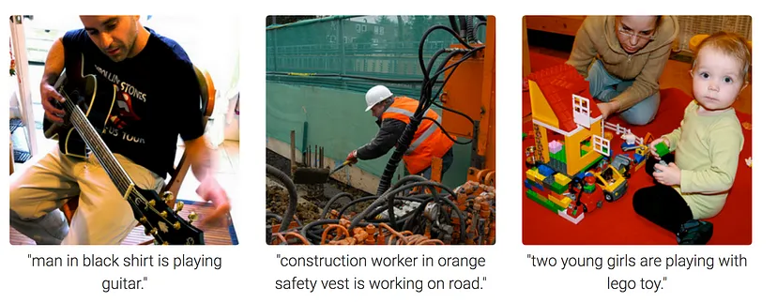
Image Captioning
Figure taken from medium

Slide 29
References
https://d2l.ai/chapter_introduction/index.html
https://udlbook.github.io/udlbook/

